Slide 1


Enhancing Transparency in Donations
Many donors feel uncertain about how their contributions are being used, which creates reluctance towards ongoing donations. Current charitable platforms often lack the necessary transparency and emotional engagement. There is a pressing need for a user-friendly dashboard that enables donors to track their contributions, see the impact of their donations, and connect with real stories from beneficiaries.

Slide 2





Understanding Donor Hesitation
1
Lack of Visualization
Donors often struggle to visualize the impact of their contributions.
2
Emotional Disconnect
Charity platforms focus more on transactions than emotional connections.
3
Need for Transparency
A transparent system can alleviate donor concerns about contribution usage.

Slide 3






Current Charity Platform Issues
2
Limited Impact Reporting
Minimal information on how funds are utilized leaves donors uninformed.
Transactional Focus
Existing platforms focus predominantly on donation processing.
1
Lack of Engagement Features
Current platforms do not facilitate interaction or learning about charities.
3

Slide 4








The Significance of a Dashboard
1
2
3
Visual Tracking of Donations
Impact Metrics
Real Stories
Including metrics that measure the impact of donations fosters trust and loyalty.
Sharing beneficiaries' stories creates a personal connection and emotional engagement.
A user-friendly dashboard allows donors to track their contributions over time.

Slide 5



Key Features of the Dashboard
User-Friendly Interface
Real-Time Updates
Customizable Metrics
Ensures accessibility for all donors.
Displays immediate donation impact.
Allows donors to focus on their values.

Slide 6
Enhancing Donor Trust
Transparency Reports
2
Providing detailed reports on fund allocation and project outcomes can enhance credibility and reassure donors of the ethical use of their financial support.
Regular Updates
Regular communication and updates through the dashboard will keep donors informed, reinforcing their trust and commitment to the cause.
1
Feedback Mechanism
Including a way for donors to give feedback on their experience can promote a culture of transparency and continuous improvement.
3

Slide 7








Emotional Engagement Strategies
1
2
3
Storytelling Elements
Visual Content
Community Involvement
Incorporating storytelling elements in the dashboard can showcase how donations have transformed lives, making the experience more meaningful for donors.
Utilizing images and videos of beneficiaries can create a powerful emotional connection, encouraging donors to continue their support.
Highlighting community events and donor contributions fosters a sense of belonging and shared purpose among donors.

Slide 8
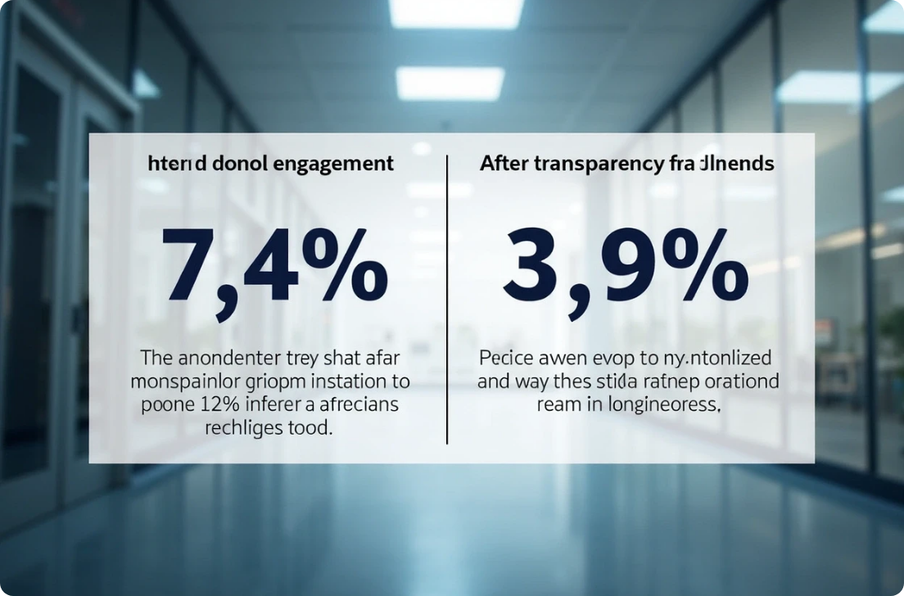

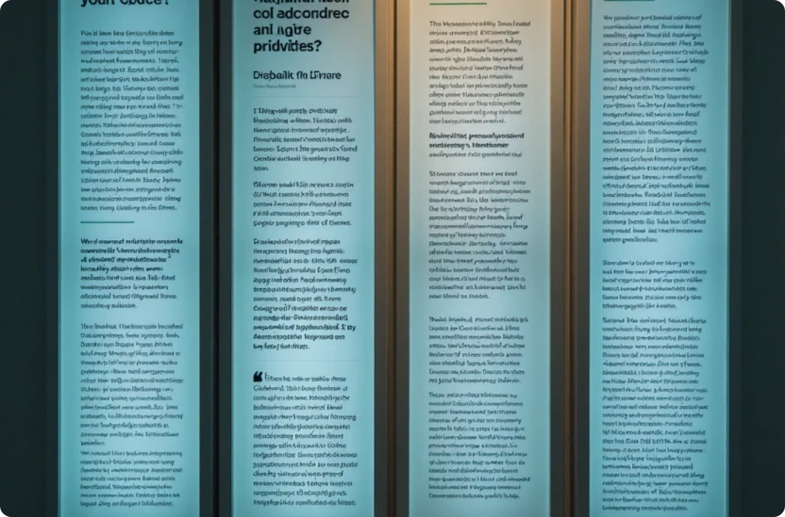
Real-World Examples
Case Studies
Pilot Programs
Feedback from Donors
Successful charities implementing transparency measures boosting donor engagement.
Testing user-friendly interfaces that enhance donor interaction.
Testimonials highlighting the impact of transparency on donor support.

Slide 9




Implementing the Solution
This section outlines the important steps necessary for effective implementation of the recommended dashboard solution. It includes a comprehensive development plan, essential technology requirements, and a strategy for testing and feedback to ensure the platform meets user expectations.
1
2
3
Development Plan
Technology Requirements
Testing and Feedback
Outline a step-by-step plan for developing the recommended dashboard.
Identify the necessary technology stack to support the dashboard’s features.
Plan for user testing and gathering feedback from potential users.

Slide 10




Conclusion of Donation Dashboard Implementation
Long-Term Benefits
Call to Action
Vision for the Future
Emphasize the long-term benefits of implementing a transparent and engaging donation dashboard, highlighting the potential for increased regular contributions.
Encourage stakeholders to advocate for the adoption of such a system within their organizations, promising a more positive donation experience.
Present a vision of a future where donors feel more connected and valued, helping to foster a sustainable culture of giving within the community.

Slide 11
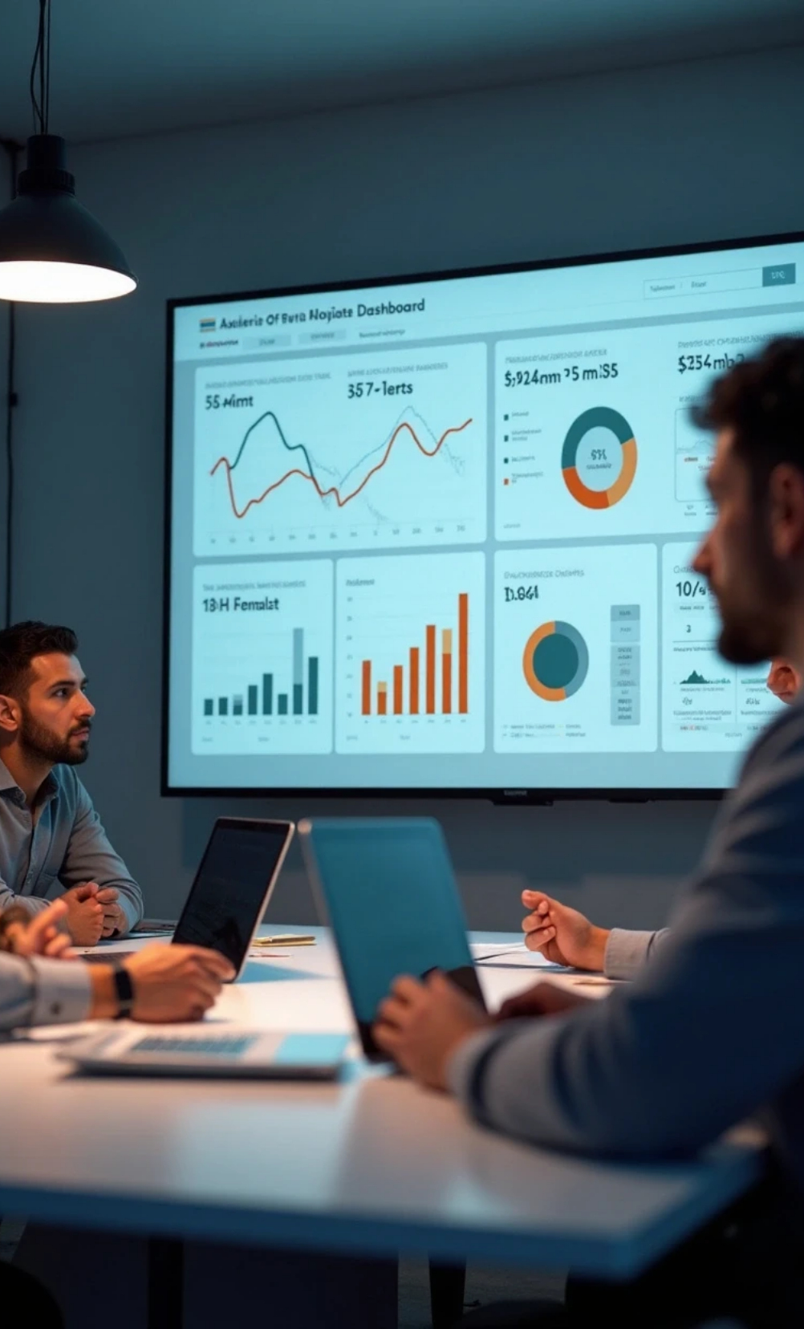



Next Steps for Project Implementation
Stakeholder Buy-In
Engage key stakeholders to gain buy-in for the project, emphasizing the potential for improved donor relations and increased contributions.
Budget Allocation
Discuss the budget requirements for developing the dashboard and how it can lead to a return on investment through increased donor engagement.
Timeline Establishment
Create a timeline for implementation, including critical milestones and review points to ensure the project remains on track.

Slide 12



Enhancing Donor Engagement and Transparency
Final Thoughts
2
Encourage ongoing discussions about improving donor experiences and the importance of innovation in the charity sector.
Key Takeaways
Recap the need for transparency and emotional engagement in donation processes and how a dedicated dashboard can address these needs.
1
Contact Information
Provide contact information for further questions or collaborations regarding the development of the dashboard and its implementation.
3

